Slide 1

Module 3: Taxes

Slide 2
Module overview
Taxes are an important consideration. Without proper planning and preparation, the government could take more than 50% of your gains (in rare circumstances)
Minimizing taxes should help you to maximize your wealth
Be certain to comply with all applicable tax rules, shortcuts can be very expensive in this area

Slide 3
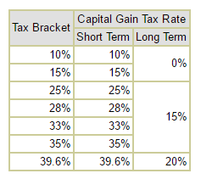
For individual traders, tax rates can be high
Traders usually face short-term capital gains

Slide 4
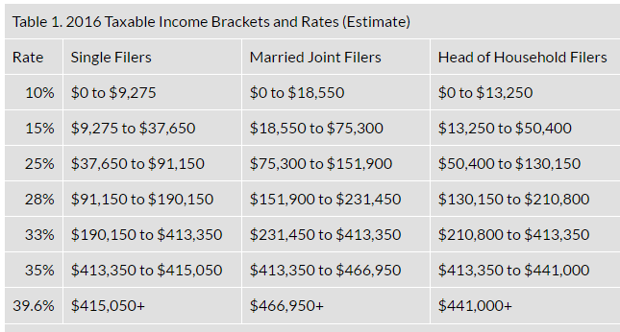
Tax rates for many traders will be 25% to 33%
Source: Tax Foundation
According to the World Top Incomes Database, a household income of about $113,000
places you in the top 10% of US incomes

Slide 5
Deductions can be determined by your status
Many traders have costs of doing business
Subscription services for trading ideas or news
Data feeds
Software
Books and courses for professional development
Computers
Internet connectivity
Office or home office expenses
Individuals can deduct these expenses as miscellaneous deductions*
*To the extent they exceed 2% of adjusted gross income (AGI)

Slide 6
Trader status
Declaring trader status allows you to fully deduct expenses
Treats expenses as business deductions rather than as miscellaneous deductions
Business deductions are not subject to the 2% floor
Trader status also removes the $3,000 annual limit for capital losses and frees you from wash sale rules
Allows for tax-favored funding of retirement plans and health insurance premiums

Slide 7
Declaring trader status
A simple and straightforward process
Requires filing a Schedule C with business expenses rather than deducting them as personal expenses
Unfortunately, few traders will qualify
To qualify, trading must be your primary source of income; trades must be made daily and trading must be short-term
In general, you would need to have no income from a job and be a day trader with at least 250 or more trades per year to qualify

Slide 8
IRS Requirements (Tax Topic 429)
You must meet all of the following conditions:
You must seek to profit from daily market movements in the prices of securities and not from dividends, interest, or capital appreciation;
Your activity must be substantial; and
You must carry on the activity with continuity and regularity.
The following facts and circumstances should be considered:
Typical holding periods for securities bought and sold;
The frequency and dollar amount of your trades during the year;
The extent to which you pursue the activity to produce income for a livelihood; and
The amount of time you devote to the activity.

Slide 9
Independent experts usually advise
You need a substantial portion of your liquid net worth trading the market. Ideally even using margin.
There should be weekly sells, or preferably daily sells.
There should probably be at least 200 to 500 significant sells per year with a minimum of 1/36th of the year’s number of sells occurring in each month.
Traders with 1,000 or more significant sells per year usually clearly qualify
With less than 200 sells it might not be possible
Traders with 200 to 1,000 might qualify but may be under more scrutiny during an audit
Typical holding period for most sells should be less than 1 month, ideally a day
You should spend a good part of most every day watching & trading the markets, typically not having a “regular day job” or generating large amounts of interest or dividend income
You should maintain a business-like operation: good records, continuing education

Slide 10
Do not claim trader status unless you qualify
If you claim trader status, expect the IRS to demand proof that you qualify
There are significant risks associated with filing under trader status if you do not meet IRS qualifications
Back taxes, interest on back taxes and penalties can be substantial
Expert advice: only claim trader status if trading is your only job and you have no other funds available to support yourself. Otherwise consider forming a separately filing entity

Slide 11
An alternative to trader status
A business organization could provide many of the same benefits as trader status
The business will become a “separately filing entity”
It will be required to generate its own tax forms
The business entity could be a corporation or partnership
It’s possible it could be a sole proprietorship but that could be difficult to support

Slide 12
Important considerations for setting up a separate entity
In an audit, expect to demonstrate the trading entity had all it’s capital in the market (even on margin) and was actively trading it
There should be monthly sells, preferably weekly or daily sells
There should probably be at least 100 to 300 significant sells per year with a minimum of 1/36th of the year’s number of sells occurring in each month (ideally, each week)
The typical holding period for most sells should be less than 4 months, preferably 1 month or less; ideally less than a week
The entity should spend a good part of most every day watching and trading the markets during trading hours
The entity should maintain a business-like operation: good books and records, continuing education

Slide 13
Potential tax forms you may need
1120 for C-corp
1120-S for S-corp
1065 for partnerships with K-1s to partners
941, Employer's Quarterly Federal Tax Return
1040-ES for quarterly tax payments

Slide 14
Lower hurdle for a business entity
Business entity could be set up to pass through income and deductions
S-corp or partnership is treated as a pass-through entity
No floor for miscellaneous deductions because business takes deductions
Business could deduct more than $3,000 in capital losses in a losing year
Business could employ more diverse strategies than an individual with trader status
Dividends would not be as large a concern

Slide 15
Before setting up a business, consider obtaining an EIN
Federal Employer Identification Number
Can be done online at
https://www.irs.gov/Businesses/Small-Businesses-&-Self-Employed/Apply-for-an-Employer-Identification-Number-(EIN)-Online
You will want to open business accounts (bank and brokerage) with an EIN rather than a Social Security number

Slide 16
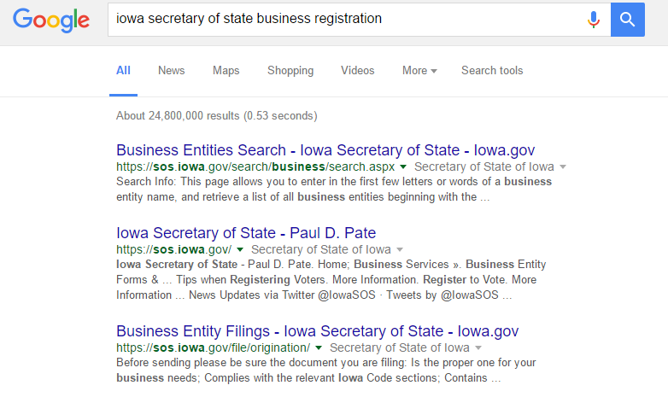
Entities
Must be set up properly with state
Google: “state name” secretary of state business registration, for example Iowa secretary of state business registration

Slide 17
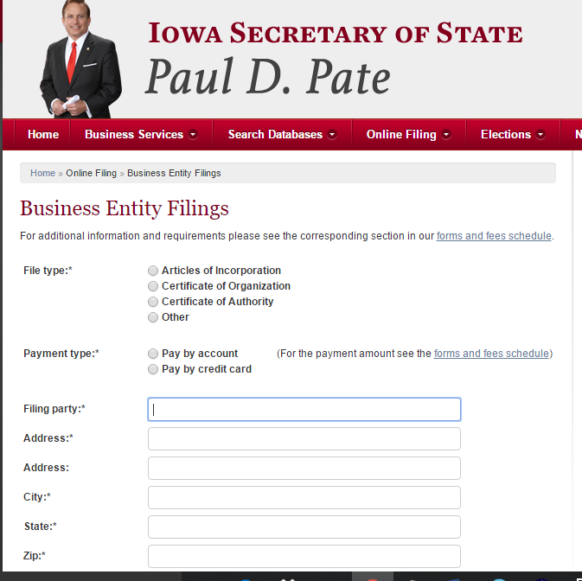

Slide 18
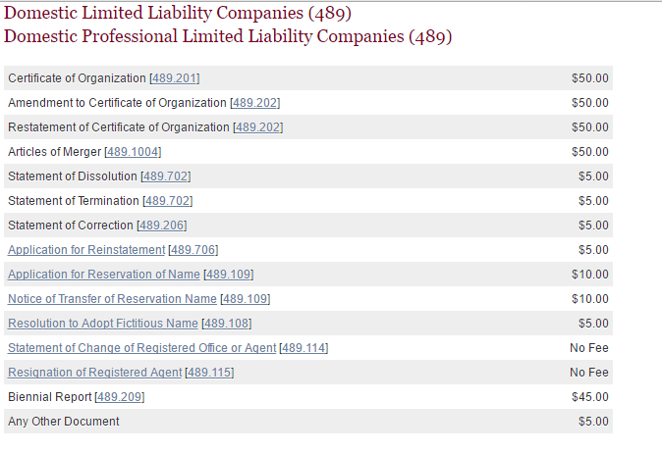
Fees are usually low. In Iowa same for LLC or Corp
$50 to form the business; $45 to file biennial report

Slide 19
Once you have an entity
Many states require you to open a business banking account in the state you registered in
As a business involved in trading, you should probably have at least two brokerage accounts
One will be a backup for the other so use different brokers
Develop a business continuity plan that shows how you will trade if you lose internet connectivity and need to phone an order in

Slide 20
Right from the start, create good books
Set up an accounting system tracking all cash deposits and withdrawals to business accounts
This will show the business shareholder or partner’s equity
This will show deductible expenses if withdrawals are for allowable costs
Pay business expenses from business accounts and pay personal expenses from personal accounts

Slide 21
Is this worth your time and effort?
Setting up an entity and tracking expenses will require time
Be sure the payoff is worth the effort

Slide 22
Real world example
Income from trading: $126,037
Potential tax due if reported as investment income: $17,947
Treating as a business, deductions
Travel to conferences for continuing education: $14,903
Conference fees: $1,354
Books for continuing education: $437
Meals with colleagues: $6,782
Tax filing and legal fess: $322
Vehicle to drive to meetings: $39,564
Home office: $7,368
Computers: $1,836
Cell phone: $1,430
Cable TV for news (basic package): $603
Data subscriptions: $3,600
Newspaper/magazines: $1,114

Slide 23
In this case, it’s worth the effort
Income from trading as a business: $126,037
Less deductions of $79,313
Taxable income: $46,724
MTM for 60/40 allocation (60% LT/40% ST)
Taxes due = $743 for capital gains + $3,573 in self employment taxes
Total taxes due for trading as a business: $4,317
Potential tax due if reported as investment income: $17,947
Savings: $13,630

Slide 24
Possible deductions
Home office
Utilities
Insurance
Maintenance
Office furniture
Travel expenses for continuing education
Seminars
Courses
Visits with experts
Meals & entertainment
50% deduction for meals which serve a professional purpose
Subscriptions
Data services
Newspapers
Business magazines
Portion of cable or satellite television

Slide 25
More possible deductions
Portion of cell phone
Portion of broadband service
Computer
Printer
Office equipment
Tax preparation
Potential employees
Vehicle
Mileage to and from meetings or other business use ($0.54 per mile)
or
Actual vehicle expenses
Section 179 allows for bonus depreciation and could be worth $25,000 a year or more

Slide 26
Bottom line
Tax savings are a consideration for many traders
Trader status can be difficult to achieve
A business entity set up specifically for trading could be the best solution for many traders

Slide 27
What’s next?
Create your business plan

